Slide 1


Slide 2
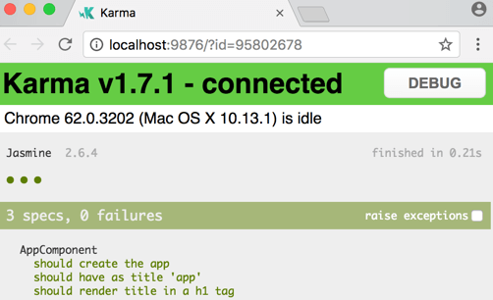
What is unit testing?
Unit testing in Angular refers to the practice of testing individual units of code in isolation to ensure they function correctly.
In the context of Angular, a unit typically refers to a component, service, directive, or pipe.
It helps developer to add new features without breaking existing code.

Slide 3
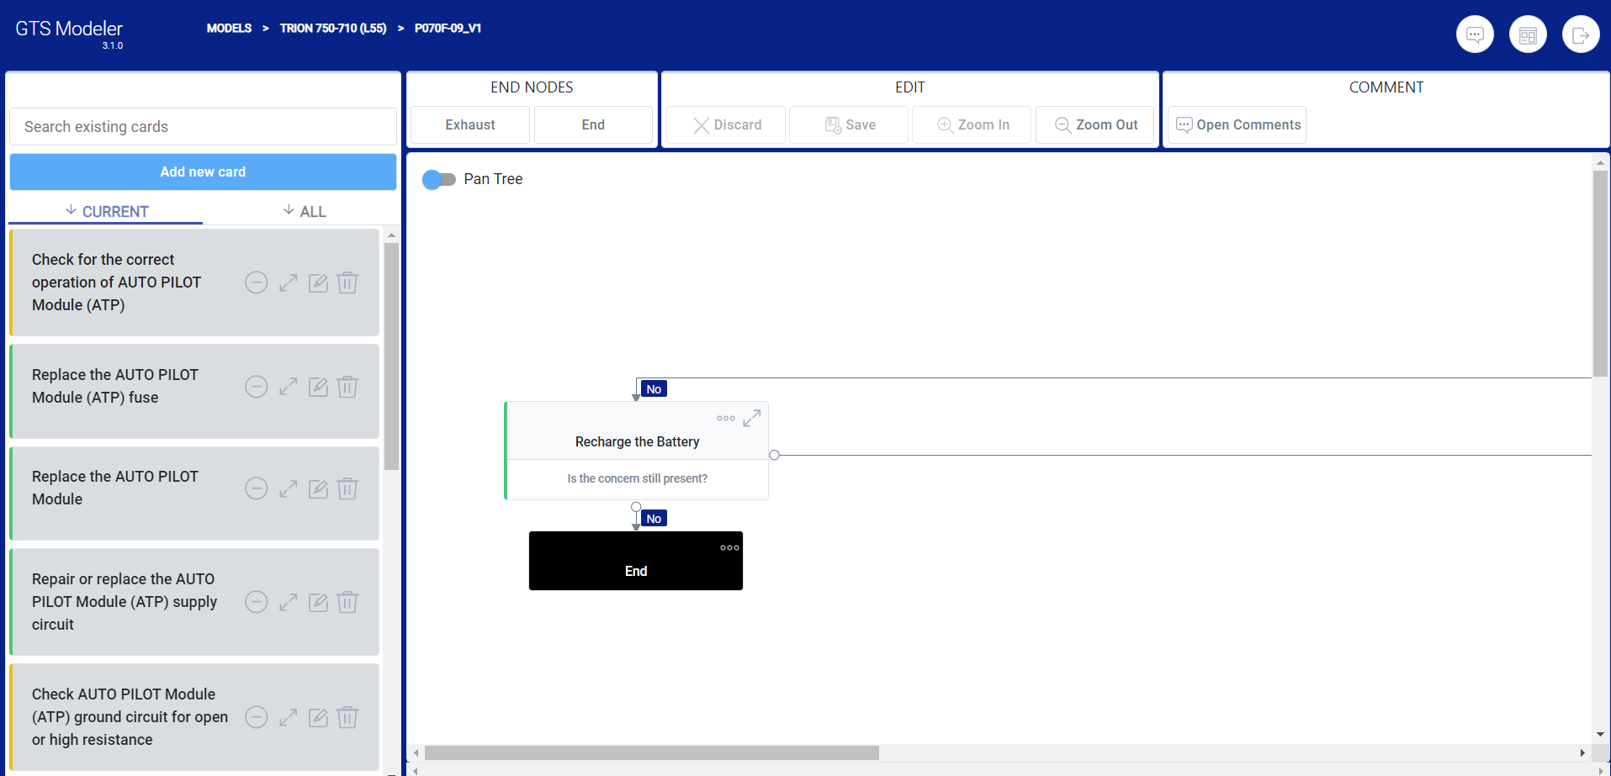

Slide 4


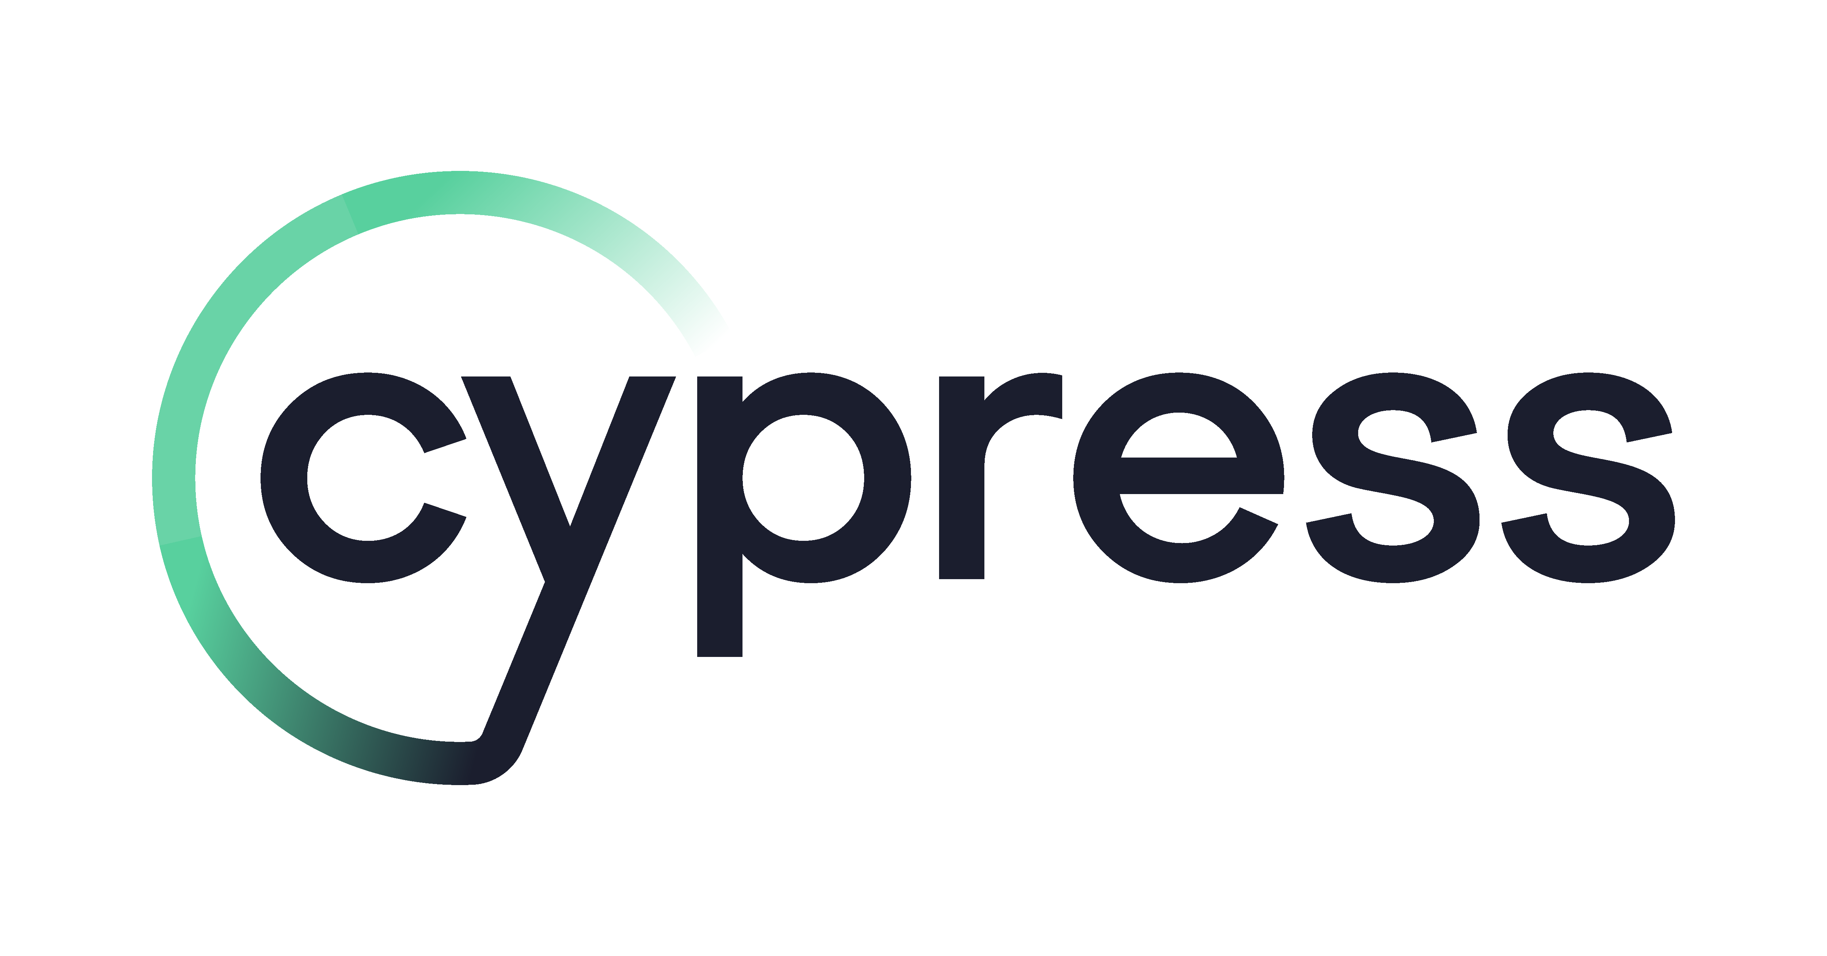

Unit testing is an essential part of the software development process as it helps to catch bugs early, verify the expected behavior of components or services, and maintain code quality and reliability.
Angular provides several tools and frameworks, such as Jasmine and Karma, to facilitate unit testing.
There is no one size fits all.

Slide 5


Slide 6


Slide 7

Why unit testing when we have manual?
Automation and Efficiency: Unit tests can be automated, meaning they can be executed quickly and repeatedly with minimal effort.
Isolation and Debugging: Unit tests focus on testing one unit at a time, isolating it from other dependencies or external factors.
Collaboration and Code Quality: Unit testing promotes collaboration among team members.
.
Automated unit testing + the insights gained from manual testing,
developers can minimizes the risk of critical issues

Slide 8
Key features unit testing in Angular
Mocking Dependencies- In unit testing, it's common to mock or stub dependencies that a unit (component or service) relies on.
Testing Components- You can write tests to verify the rendering, behavior, and interactions of Angular components.
Testing Services- Services in Angular can be tested independently by providing any required dependencies and testing their methods or functionality. You can create instances of services using TestBed.get or dependency injection and verify their behavior through assertions.
Testing Directives and Pipes

Slide 9
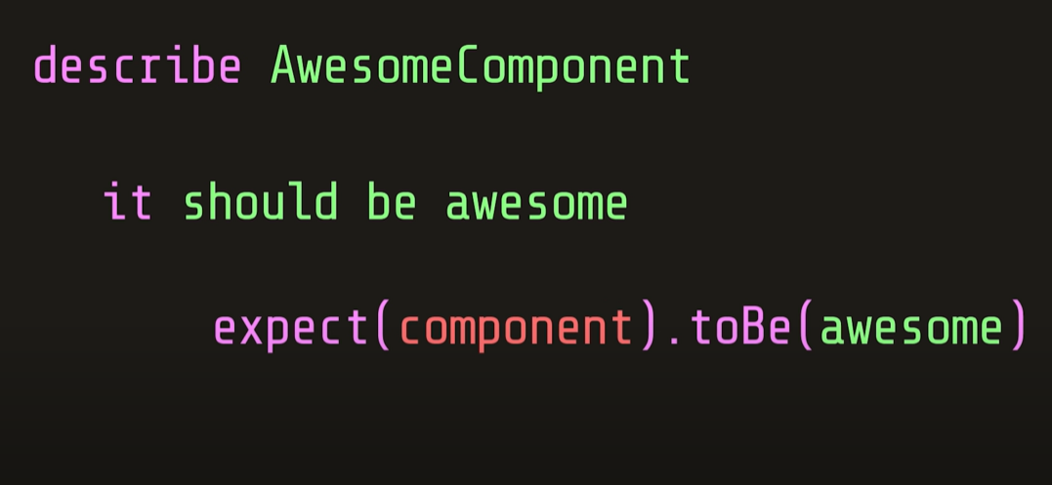
Typical test case

Slide 10
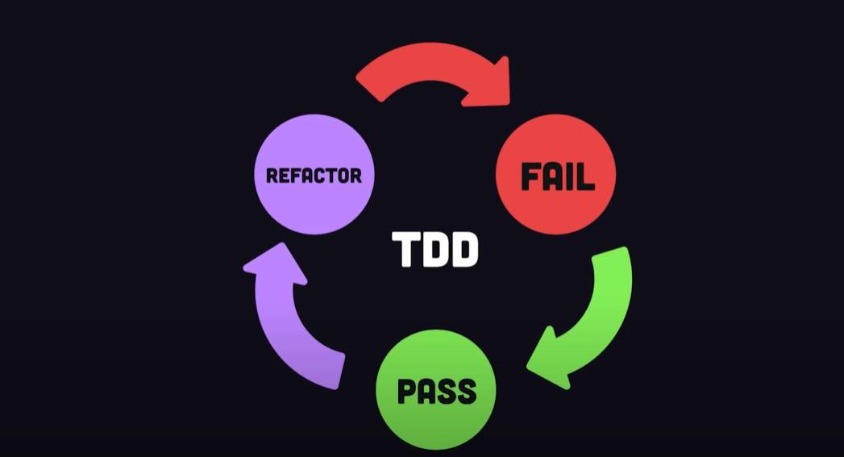

Slide 11
Talk is CHEAP.
Show me the CODE.

